Slide 1
Evolution over time of the structure of social graphs
Student Leonardo Serilli
Supervisors Frédéric Giroire, Malgorzata Sulkowska, Nicolas Nisse
Year 2021/2022

Slide 2
INTRODUCTION
01
STATE OF THE ART
02
DEGREE DISTRIBUTION
DATA PREPARATION
TABLE OF CONTENTS
04
03
VERTEX TRAJECTORIES
05
06
NEXT STEPS
Context
Scope of the project
Data
Network evolution over time
Powerlaw and scale free networks
Powerlaw in real world networks
Theoretical model
Matching model
Degree Distribution Retrieval
Degree Distribution Fitting
Which researchers should be taken into account?
How to interpret a time step?
Average Trajectories
Fitting Trajectories
General Fitting
Results

Slide 3
01
INTRODUCTION
Context
Scope of the project
Data

Slide 4
CONTEXT
Scopus Database

Slide 5

CONTEXT
Scopus Database

Slide 6
CONTEXT
Scopus Database
250K computer science authors
Collaborations (co-authorship relationship) between 1990 and 2018

Slide 7
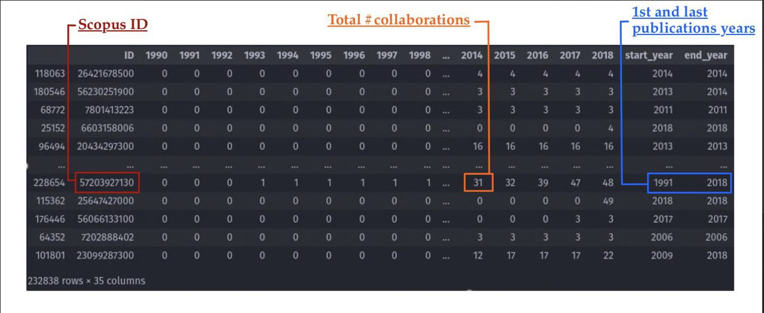
CONTEXT
Scopus Database
250K computer science authors
Collaborations (co-authorship relationship) between 1990 and 2018

Slide 8
SCOPE OF THE PROJECT
Build the collaboration network G=(V,E) | V = {authors}, E = {collaborations};

Slide 9
SCOPE OF THE PROJECT
Build the collaboration network G=(V,E) | V = {authors}, E = {collaborations}.
Study some of it's mathematical properties and their evolution over time;

Slide 10
SCOPE OF THE PROJECT
Build the collaboration network G=(V,E) | V = {authors}, E = {collaborations}.
Study some of it's mathematical properties and their evolution over time.
Implement a model to generate similar graphs and so able to predict their evolution .

Slide 11
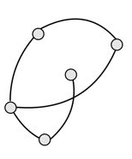
SCOPE OF THE PROJECT
Build the collaboration network G=(V,E) | V = {authors}, E = {collaborations}.
Study some of it's mathematical properties and their evolution over time.
Implement a model to generate similar graphs and so able to predict their evolution .
G₁₉₉₀

Slide 12
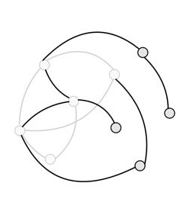
SCOPE OF THE PROJECT
Build the collaboration network G=(V,E) | V = {authors}, E = {collaborations}.
Study some of it's mathematical properties and their evolution over time.
Implement a model to generate similar graphs and so able to predict their evolution .
G₁₉₉₁
G₁₉₉₀

Slide 13
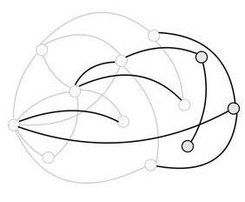
SCOPE OF THE PROJECT
Build the collaboration network G=(V,E) | V = {authors}, E = {collaborations}.
Study some of it's mathematical properties and their evolution over time.
Implement a model to generate similar graphs and so able to predict their evolution .
G₁₉₉₂
G₁₉₉₁
G₁₉₉₀

Slide 14
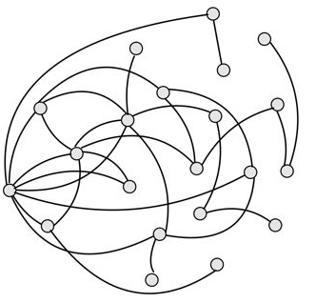
SCOPE OF THE PROJECT
Build the collaboration network G=(V,E) | V = {authors}, E = {collaborations}.
Study some of it's mathematical properties and their evolution over time.
Implement a model to generate similar graphs and so able to predict their evolution .
G₂₀₁₈
G₁₉₉₂
G₁₉₉₁
G₁₉₉₀

Slide 15
RELEVANT PROPERTIES
Vertex trajectory d_{v}(y): degree of v at the given year y;

Slide 16
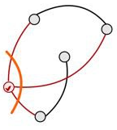
RELEVANT PROPERTIES
Vertex trajectory d_{v}(y): degree of v at the given year y;
dv(1990)= 3

Slide 17
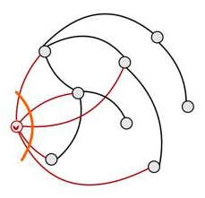
RELEVANT PROPERTIES
Vertex trajectory d_{v}(y): degree of v at the given year y;
dv(1991)= 5
dv(1990)= 3

Slide 18
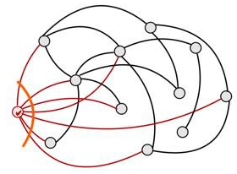
RELEVANT PROPERTIES
Vertex trajectory d_{v}(y): degree of v at the given year y;
dv(1992)= 7
dv(1991)= 5
dv(1990)= 3

Slide 19
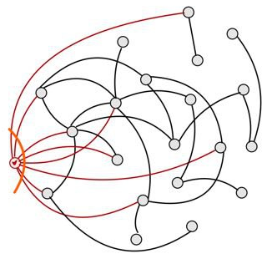
RELEVANT PROPERTIES
Vertex trajectory d_{v}(y): degree of v at the given year y;
dv(2018)= 8
dv(1992)= 7
dv(1991)= 5
dv(1990)= 3

Slide 20
RELEVANT PROPERTIES
Vertex trajectory d_{v}(y): degree of v at the given year y;

Slide 21
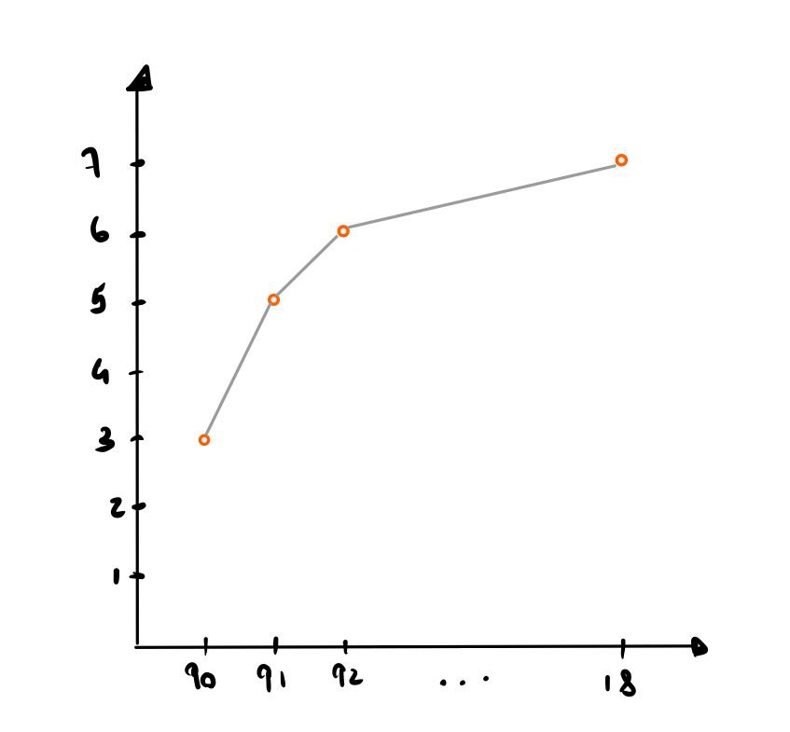
RELEVANT PROPERTIES
Vertex trajectory d_{v}(y): degree of v at the given year y;
d_{v}(y)
y

Slide 22
RELEVANT PROPERTIES
Vertex trajectory d_{v}(y): degree of v at the given year y;
Degree Distribution Mk: fraction of #nodes of degree k. over the total #nodes.

Slide 23
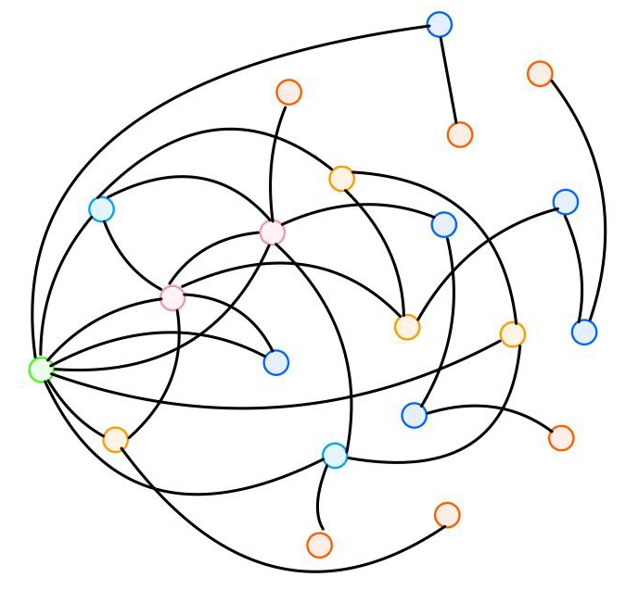
RELEVANT PROPERTIES
Vertex trajectory d_{v}(y): degree of v at the given year y;
Degree Distribution Mk: fraction of #nodes of degree k over the total #nodes.
G₂₀₁₈

Slide 24
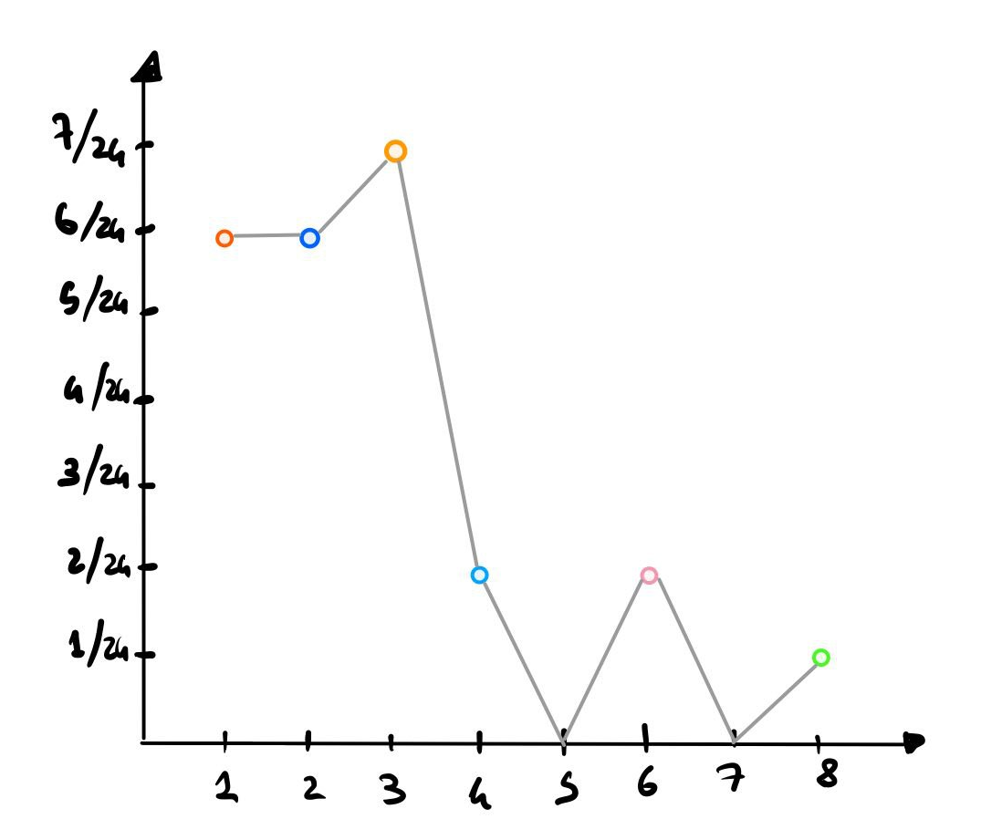
RELEVANT PROPERTIES
Vertex trajectory d_{v}(y): degree of v atthe given year y;
Degree Distribution Mk: fraction of #nodes of degree k over the total #nodes.
G₂₀₁₈
Mk
k

Slide 25
02
STATE OF THE ART
Network evolution over time
Powerlaw and scale free networks
Powerlaw in real world networks
Theoretical model
Matching model

Slide 26
NETWORK EVOLUTION OVER TIME
G = (V, E) evolves over time.

Slide 27
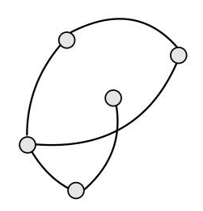
NETWORK EVOLUTION OVER TIME
G = (V, E) evolves over time.
Two kinds of event:

Slide 28
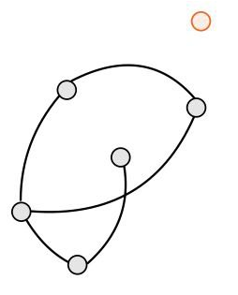
NETWORK EVOLUTION OVER TIME
G = (V, E) evolves over time.
Two kinds of event:
Node + Edge event, probability p

Slide 29
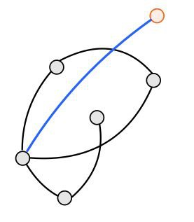
NETWORK EVOLUTION OVER TIME
G = (V, E) evolves over time.
Two kinds of event:
Node + Edge event, probability p

Slide 30
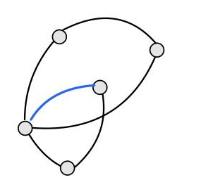
NETWORK EVOLUTION OVER TIME
G = (V, E) evolves over time.
Two kinds of event:
Node + Edge event, probability p
Edge event, probability (1-p)

Slide 31
NETWORK EVOLUTION OVER TIME
G = (V, E) evolves over time.
Two kinds of event:
Node + Edge event, probability p
Edge event, probability (1-p)
Let t∈N - #events occurred​
G_{t} = (V_{t}, E_{t}) graph after event t

Slide 32
NETWORK EVOLUTION OVER TIME
G = (V, E) evolves over time.
Two kinds of event:
Node + Edge event, probability p
Edge event, probability (1-p)
G_{t+1} = (V_{t+1}, E_{t+1})
Gt = (Vt, Et)
G_{t+1} = (V_{t+1}, E_{t+1})
Let t∈N - #events occurred​
G_{t} = (V_{t}, E_{t}) graph after event t

Slide 33
NETWORK EVOLUTION OVER TIME
G = (V, E) evolves over time.
Two kinds of event:
Node + Edge event, probability p
Edge event, probability (1-p)
G_{t+1} = (V_{t+1}, E_{t+1})
Gt = (Vt, Et)
G_{t+1} = (V_{t+1}, E_{t+1})
Let t∈N - #events occurred​
G_{t} = (V_{t}, E_{t}) graph after event t

Slide 34
NETWORK EVOLUTION OVER TIME
G = (V, E) evolves over time.
Two kinds of event:
Node + Edge event, probability p
Edge event, probability (1-p)
G_{t+1} = (V_{t+1}, E_{t+1})
Gt = (Vt, Et)
G_{t+1} = (V_{t+1}, E_{t+1})
Let t∈N - #events occurred​
G_{t} = (V_{t}, E_{t}) graph after event t

Slide 35
NETWORK EVOLUTION OVER TIME
G = (V, E) evolves over time.
Two kinds of event:
Node + Edge event, probability p
Edge event, probability (1-p)
G_{t+1} = (V_{t+1}, E_{t+1})
Gt = (Vt, Et)
G_{t+1} = (V_{t+1}, E_{t+1})
Let t∈N - #events occurred​
G_{t} = (V_{t}, E_{t}) graph after event t

Slide 36
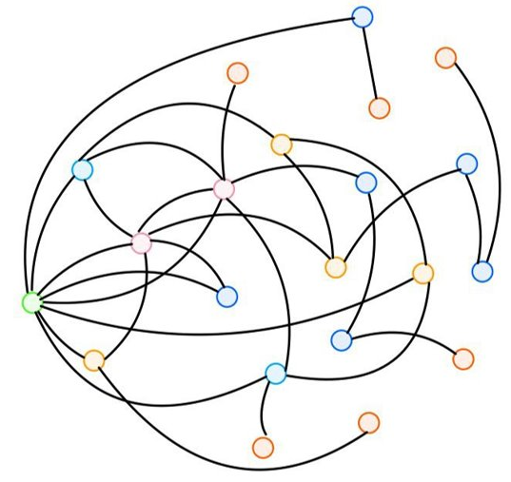
POWERLAW AND SCALE-FREE NETWORKS
G = (V, E) of n nodes
G

Slide 37
POWERLAW AND SCALE-FREE NETWORKS
G = (V, E) of n nodes
M_{k}
G
k

Slide 38
POWERLAW AND SCALE-FREE NETWORKS
G = (V, E) of n nodes
.
Degree Distribution M_{k} = n_{k} /n | n_{k} = #nodes of degree k in G.
M_{k}
G
k

Slide 39
POWERLAW AND SCALE-FREE NETWORKS
G = (V, E) of n nodes
.
Degree Distribution M_{k} = n_{k} /n | n_{k} = #nodes of degree k in G.
A scale-free network respects the powerlaw distribution Mk ∼ Ck^{-λ} | λ, C > 0.
M_{k}
G
k

Slide 40
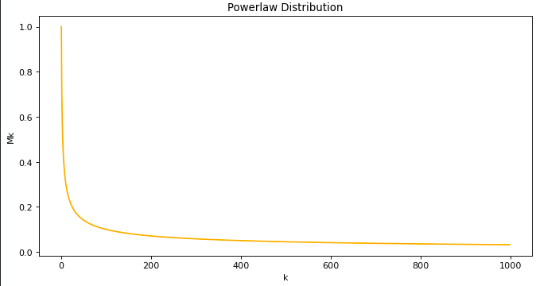
POWERLAW AND SCALE-FREE NETWORKS
G = (V, E) of n nodes
.
Degree Distribution M_{k} = n_{k} /n | n_{k} = #nodes of degree k in G.
A scale-free network respects the powerlaw distribution Mk ∼ Ck^{-λ} | λ, C > 0.
M_{k}
G
k

Slide 41
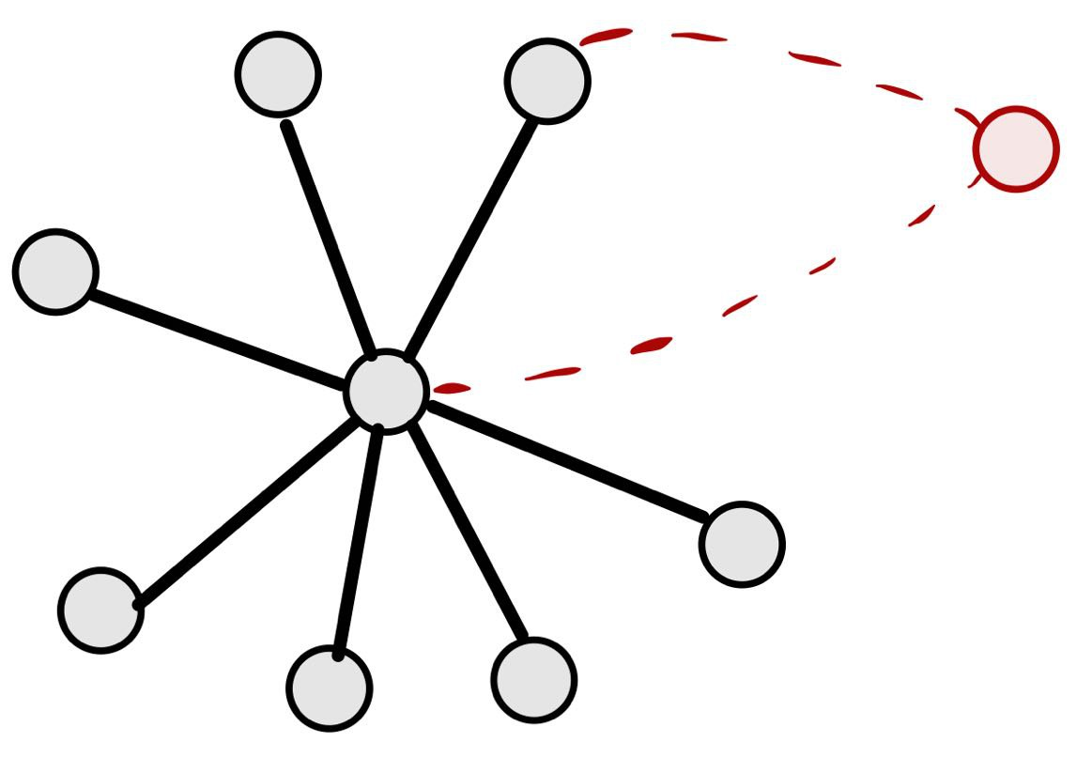
POWERLAW AND SCALE-FREE NETWORKS
G = (V, E) of n nodes
.
Degree Distribution M_{k} = n_{k} /n | n_{k} = #nodes of degree k in G.
A scale-free network respects the powerlaw distribution Mk ∼ Ck^{-λ} | λ, C > 0.
M_{k}
G
k
Low Probability
High Probability

Slide 42
POWERLAW IN REAL WORLD NETWORKS
Is often believed that most real-world networks are scale-free [1], [2], [3].

Slide 43
POWERLAW IN REAL WORLD NETWORKS
Is often believed that most real-world networks are scale-free [1], [2], [3].
References:
[1] Derek J. de Solla Price. Networks of scientific papers
[2] Michalis Faloutsos, Petros Faloutsos, and Christos Faloutsos. On power-law relationships of the Internet topology
[3] Frédéric Giroire, Nicolas Nisse, Thibaud Trolliet, Malgorzata Sulkowska. Preferential attachment hypergraph with high modularity

Slide 44
POWERLAW IN REAL WORLD NETWORKS
Is often believed that most real-world networks are scale-free [1], [2], [3].
Powerlaw Mk ∼ Ck^{-λ}
References:
[1] Derek J. de Solla Price. Networks of scientific papers
[2] Michalis Faloutsos, Petros Faloutsos, and Christos Faloutsos. On power-law relationships of the Internet topology
[3] Frédéric Giroire, Nicolas Nisse, Thibaud Trolliet, Malgorzata Sulkowska. Preferential attachment hypergraph with high modularity

Slide 45
POWERLAW IN REAL WORLD NETWORKS
Is often believed that most real-world networks are scale-free [1], [2], [3].
Powerlaw Mk ∼ Ck^{-λ}
References:
[1] Derek J. de Solla Price. Networks of scientific papers
[2] Michalis Faloutsos, Petros Faloutsos, and Christos Faloutsos. On power-law relationships of the Internet topology
[3] Frédéric Giroire, Nicolas Nisse, Thibaud Trolliet, Malgorzata Sulkowska. Preferential attachment hypergraph with high modularity

Slide 46
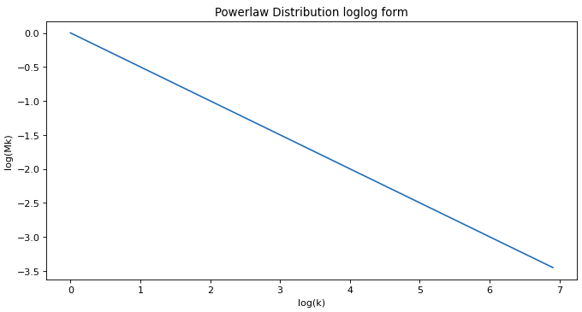
POWERLAW IN REAL WORLD NETWORKS
Is often believed that most real-world networks are scale-free [1], [2], [3].
Powerlaw Mk ∼ Ck^{-λ}
References:
[1] Derek J. de Solla Price. Networks of scientific papers
[2] Michalis Faloutsos, Petros Faloutsos, and Christos Faloutsos. On power-law relationships of the Internet topology
[3] Frédéric Giroire, Nicolas Nisse, Thibaud Trolliet, Malgorzata Sulkowska. Preferential attachment hypergraph with high modularity

Slide 47
POWERLAW IN REAL WORLD NETWORKS
Ubiquitousness of power law has been questioned [4].
References:
[4] A. D. Broido and A. Clauset, Scale-free networks are rare

Slide 48
POWERLAW IN REAL WORLD NETWORKS
Ubiquitousness of power law has been questioned [4].
Investigations shown that scale-free networks are not so widespread as thought, it turns out that many of them follow a power-law distribution with an exponential cut-off [5], [6].
References:
[4] A. D. Broido and A. Clauset, Scale-free networks are rare
[5] Mark E. J. Newman. Coauthorship networks and patterns of scientific collaboration
[6] Mark E. J. Newman. Clustering and preferential attachment in growing networks

Slide 49
POWERLAW IN REAL WORLD NETWORKS
Ubiquitousness of power law has been questioned [4].
Investigations shown that scale-free networks are not so widespread as thought, it turns out that many of them follow a power-law distribution with an exponential cut-off [5], [6].
Powerlaw with exponential cut-off M_{k} ∼ Ck^{-λ}γ^{-k} | 0≤γ<1​
References:
[4] A. D. Broido and A. Clauset, Scale-free networks are rare
[5] Mark E. J. Newman. Coauthorship networks and patterns of scientific collaboration
[6] Mark E. J. Newman. Clustering and preferential attachment in growing networks

Slide 50
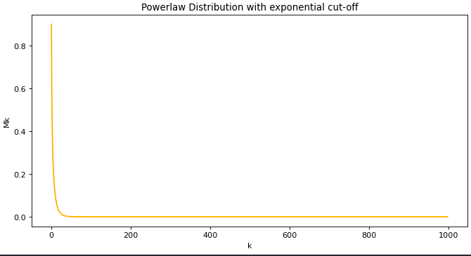
POWERLAW IN REAL WORLD NETWORKS
Ubiquitousness of power law has been questioned [4].
Investigations shown that scale-free networks are not so widespread as thought, it turns out that many of them follow a power-law distribution with an exponential cut-off [5], [6].
Powerlaw with exponential cut-off M_{k} ∼ Ck^{-λ}γ^{-k} | 0≤γ<1​
References:
[4] A. D. Broido and A. Clauset, Scale-free networks are rare
[5] Mark E. J. Newman. Coauthorship networks and patterns of scientific collaboration
[6] Mark E. J. Newman. Clustering and preferential attachment in growing networks

Slide 51
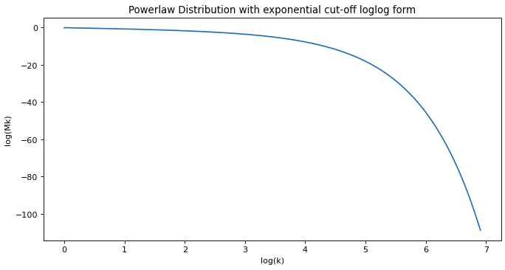
POWERLAW IN REAL WORLD NETWORKS
Ubiquitousness of power law has been questioned [4].
Investigations shown that scale-free networks are not so widespread as thought, it turns out that many of them follow a power-law distribution with an exponential cut-off [5], [6].
Powerlaw with exponential cut-off M_{k} ∼ Ck^{-λ}γ^{-k} | 0≤γ<1​
References:
[4] A. D. Broido and A. Clauset, Scale-free networks are rare
[5] Mark E. J. Newman. Coauthorship networks and patterns of scientific collaboration
[6] Mark E. J. Newman. Clustering and preferential attachment in growing networks
Notes:
Note the gamma parameter, it gives the exponential cut-off, but where that parameter comes from? (see next)

Slide 52
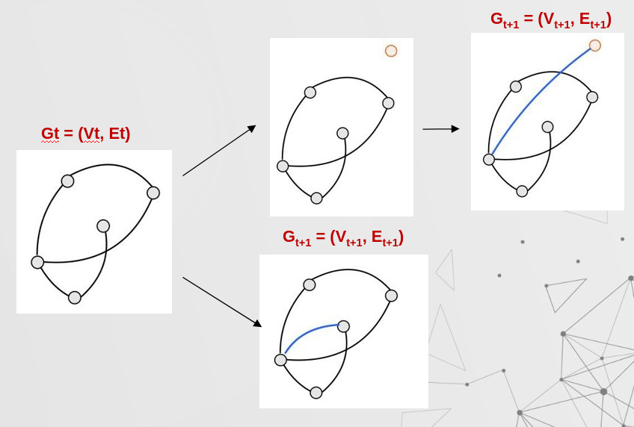
THEORETICHAL MODEL
(Node + Edge) event​, p
Edge event, (1-p)

Slide 53
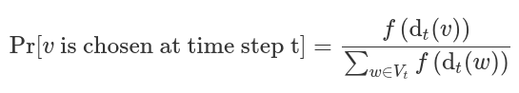
THEORETICHAL MODEL
(Node + Edge) event​, p
Edge event, (1-p)

Slide 54
THEORETICHAL MODEL
(Node + Edge) event​, p
Edge event, (1-p)
The preferrential attachment is dictated by the so called attachment function f(d_{v}(t)) = d_{v}(t)^{γ}

Slide 55
THEORETICHAL MODEL
(Node + Edge) event​, p
Edge event, (1-p)
The preferrential attachment is dictated by the so called attachment function f(d_{v}(t)) = d_{v}(t)^{γ}

Slide 56
THEORETICHAL MODEL
(Node + Edge) event​, p
Edge event, (1-p)
The preferrential attachment is dictated by the so called attachment function f(d_{v}(t)) = d_{v}(t)^{γ}
Vertex trajectory:

Slide 57
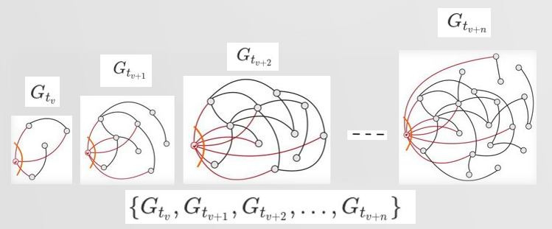
THEORETICHAL MODEL
(Node + Edge) event​, p
Edge event, (1-p)
The preferrential attachment is dictated by the so called attachment function f(d_{v}(t)) = d_{v}(t)^{γ}
Vertex trajectory:
Let t_{v} time ste in which v appears in the graph;

Slide 58
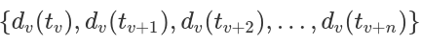
THEORETICHAL MODEL
(Node + Edge) event​, p
Edge event, (1-p)
The preferrential attachment is dictated by the so called attachment function f(d_{v}(t)) = d_{v}(t)^{γ}
Vertex trajectory:
Let t_{v} time ste in which v appears in the graph;
The vertex trajectory d_{v}(t) is thesequence:

Slide 59
MATCHING MODEL
Barabasi Albert model [7]
Given:
P = 1, so only node+edge event
γ = 1, so f(d_{v}(t)) = d_{v}(t)
References:
[7] A.-L. Barabasi and R. Albert, “Albert, R.: Emergence of Scaling in Random Networks

Slide 60
MATCHING MODEL
Barabasi Albert model [7]
Given:
P = 1, so only node+edge event
γ = 1, so f(d_{v}(t)) = d_{v}(t)
Follows:
powerlaw degree distribution Mk ∼ Ck^{-λ} ​
Vertext trajectory d_{v}(t) = t/t_{v}^{1/2}​
References:
[7] A.-L. Barabasi and R. Albert, “Albert, R.: Emergence of Scaling in Random Networks

Slide 61
MATCHING MODEL
Barabasi Albert model [7]
Given:
P = 1, so only node+edge event
γ = 1, so f(d_{v}(t)) = d_{v}(t)
Follows:
powerlaw degree distribution Mk ∼ Ck^{-λ} ​
Vertext trajectory d_{v}(t) = t/t_{v}^{1/2}​
Chung-Lu model [8]
Given:
General P and 0≤γ<1
Generalized sublinear f(d_{v}(t)) = d_{v}(t)^{γ}
References:
[7] A.-L. Barabasi and R. Albert, “Albert, R.: Emergence of Scaling in Random Networks
[8] F.Giroire, N.Nisse, M.Sulkowska, Study of a degree distribution and a vertex trajectory in the Chung-Lu model with a generalized attachment function

Slide 62

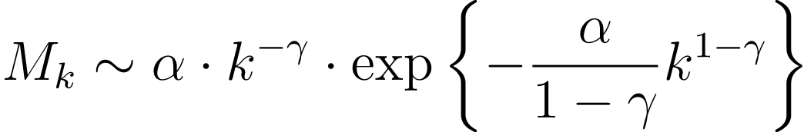
MATCHING MODEL
Barabasi Albert model [7]
Given:
P = 1, so only node+edge event
γ = 1, so f(d_{v}(t)) = d_{v}(t)
Follows:
powerlaw degree distribution Mk ∼ Ck^{-λ} ​
Vertext trajectory d_{v}(t) = t/t_{v}^{1/2}​
Chung-Lu model [8]
Given:
General P and 0≤γ<1
Generalized sublinear f(d_{v}(t)) = d_{v}(t)^{γ}
Follows :​
stretched exponential degree distribution M_{k}
References:
[7] A.-L. Barabasi and R. Albert, “Albert, R.: Emergence of Scaling in Random Networks
[8] F.Giroire, N.Nisse, M.Sulkowska, Study of a degree distribution and a vertex trajectory in the Chung-Lu model with a generalized attachment function

Slide 63
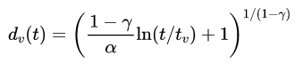
MATCHING MODEL
Barabasi Albert model [7]
Given:
P = 1, so only node+edge event
γ = 1, so f(d_{v}(t)) = d_{v}(t)
Follows:
powerlaw degree distribution Mk ∼ Ck^{-λ} ​
Vertext trajectory d_{v}(t) = t/t_{v}^{1/2}​
Chung-Lu model [8]
Given:
General P and 0≤γ<1
Generalized sublinear f(d_{v}(t)) = d_{v}(t)^{γ}
Follows :​
stretched exponential degree distribution M_{k}
logarithmic vertex trajectory d_{v}(t)
References:
[7] A.-L. Barabasi and R. Albert, “Albert, R.: Emergence of Scaling in Random Networks
[8] F.Giroire, N.Nisse, M.Sulkowska, Study of a degree distribution and a vertex trajectory in the Chung-Lu model with a generalized attachment function

Slide 64
MATCHING MODEL
Barabasi Albert model [7]
Given:
P = 1, so only node+edge event
γ = 1, so f(d_{v}(t)) = d_{v}(t)
Follows:
powerlaw degree distribution Mk ∼ Ck^{-λ} ​
Vertext trajectory d_{v}(t) = t/t_{v}^{1/2}​
Chung-Lu model [8]
Given:
General P and 0≤γ<1
Generalized sublinear f(d_{v}(t)) = d_{v}(t)^{γ}
Follows :​
stretched exponential degree distribution M_{k}
logarithmic vertex trajectory d_{v}(t)
References:
[7] A.-L. Barabasi and R. Albert, “Albert, R.: Emergence of Scaling in Random Networks
[8] F.Giroire, N.Nisse, M.Sulkowska, Study of a degree distribution and a vertex trajectory in the Chung-Lu model with a generalized attachment function

Slide 65
03
FACED PROBLEMS
(1) Which researchers should be taken into account?
(2) How to interpret a time step?

Slide 66
(1) Which researchers should be taken into account?
Problem
We faced the following issues trying to define what an active author is:

Slide 67
(1) Which researchers should be taken into account?
Problem
We faced the following issues trying to define what an active author is:
Authors with low publication rate, too many years of inativity;.

Slide 68
(1) Which researchers should be taken into account?
Problem
We faced the following issues trying to define what an active author is:
Authors with low publication rate, too many years of inativity;
Authors with few years of research activity, like students who stopped publishing after their PhD;

Slide 69
(1) Which researchers should be taken into account?
Problem
We faced the following issues trying to define what an active author is:
Authors with low publication rate, too many years of inativity;
Authors with few years of research activity, like students who stopped publishing after their PhD;
Authors with few publications.

Slide 70
(1) Which researchers should be taken into account?
Problems
We faced the following issues trying to define what an active author is:
Authors with low publication rate, too many years of inativity;
Authors with few years of research activity, like students who stopped publishing after their PhD;
Authors with few publications.
Solutions:
We defined active authors by the following metrics:

Slide 71
(1) Which researchers should be taken into account?
Problems
We faced the following issues trying to define what an active author is:
Authors with low publication rate, too many years of inativity;
Authors with few years of research activity, like students who stopped publishing after their PhD;
Authors with few publications.
Solutions:
We defined active authors by the following metrics:
Hole size: #years without publishing;

Slide 72
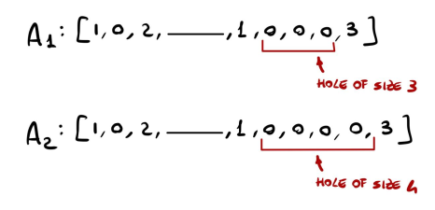
(1) Which researchers should be taken into account?
Problems
We faced the following issues trying to define what an active author is:
Authors with low publication rate, too many years of inativity;
Authors with few years of research activity, like students who stopped publishing after their PhD;
Authors with few publications.
Solutions:
We defined active authors by the following metrics:
Hole size: #years without publishing;

Slide 73
(1) Which researchers should be taken into account?
Problems
We faced the following issues trying to define what an active author is:
Authors with low publication rate, too many years of inativity;
Authors with few years of research activity, like students who stopped publishing after their PhD;
Authors with few publications.
Solutions:
We defined active authors by the following metrics:
Hole size: #years without publishing;
Activity period: #years between 1st and last publication;

Slide 74
(1) Which researchers should be taken into account?
Problems
We faced the following issues trying to define what an active author is:
Authors with low publication rate, too many years of inativity;
Authors with few years of research activity, like students who stopped publishing after their PhD;
Authors with few publications.
Solutions:
We defined active authors by the following metrics:
Hole size: #years without publishing;
Activity period: #years between 1st and last publication;
Publication number: total #publications .

Slide 75
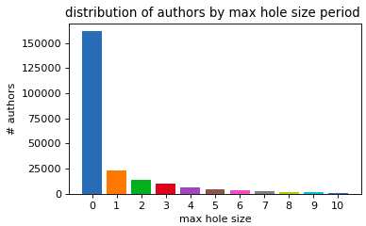
(1) Which researchers should be taken into account?
Hole size
(#years without publishing)

Slide 76
(1) Which researchers should be taken into account?
Hole size
(#years without publishing)
To include researcher who take a sabathical year from teaching every seven to do research
≤ 7

Slide 77
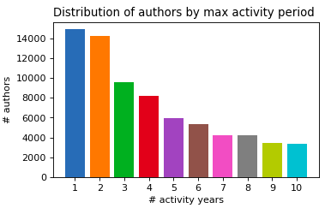
(1) Which researchers should be taken into account?
&
Activity period ​
(#years between 1st and last publication)
Hole size
(#years without publishing)
To include researcher who take a sabathical year from teaching every seven to do research
≤ 7

Slide 78
(1) Which researchers should be taken into account?
&
Activity period ​
(#years between 1st and last publication)
Hole size
(#years without publishing)
To include researcher who take a sabathical year from teaching every seven to do research
To exlude PhD students
≤ 7
≥ 5

Slide 79
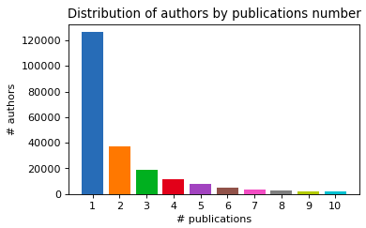
(1) Which researchers should be taken into account?
&
Activity period ​
(#years between 1st and last publication)
&
Hole size
(#years without publishing)
#publications
To include researcher who take a sabathical year from teaching every seven to do research
To exlude PhD students
≤ 7
≥ 5

Slide 80
(1) Which researchers should be taken into account?
&
Activity period ​
(#years between 1st and last publication)
&
Hole size
(#years without publishing)
#publications
To include researcher who take a sabathical year from teaching every seven to do research
To exlude PhD students
Good compromise between insight and #authors filtered
≤ 7
≥ 5
≥ 3

Slide 81
(1) Which researchers should be taken into account?
&
Activity period ​
(#years between 1st and last publication)
&
Hole size
(#years without publishing)
#publications
To include researcher who take a sabathical year from teaching every seven to do research
To exlude PhD students
Good compromise between insight and #authors filtered
≤ 7
≥ 5
≥ 3
=> 16% of data left

Slide 82
(2) How to interpret a time step?

Slide 83
(2) How to interpret a time step?
SOA time step definition: G_{t} = (V_{t}, E_{t}) graph after event t | t∈N - #events occurred ((Node + Edge) and Edge event)

Slide 84
(2) How to interpret a time step?
SOA time step definition: G_{t} = (V_{t}, E_{t}) graph after event t | t∈N - #events occurred ((Node + Edge) and Edge event)
We have the state of the graph for each year, so a too small set of events to build the logarithmic vertex trajectories we want to match with our model.

Slide 85
(2) How to interpret a time step?
SOA time step definition: G_{t} = (V_{t}, E_{t}) graph after event t | t∈N - #events occurred ((Node + Edge) and Edge event)
We have the state of the graph for each year, so a too small set of events to build the logarithmic vertex trajectories we want to match with our model.
Other metrics as event : the occurrence of a new author

Slide 86
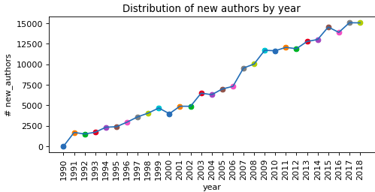
(2) How to interpret a time step?
SOA time step definition: G_{t} = (V_{t}, E_{t}) graph after event t | t∈N - #events occurred ((Node + Edge) and Edge event)
We have the state of the graph for each year, so a too small set of events to build the logarithmic vertex trajectories we want to match with our model.
Other metrics as event : the occurrence of a new author

Slide 87
(2) How to interpret a time step?
SOA time step definition: G_{t} = (V_{t}, E_{t}) graph after event t | t∈N - #events occurred ((Node + Edge) and Edge event)
We have the state of the graph for each year, so a too small set of events to build the logarithmic vertex trajectories we want to match with our model.
Other metrics as event : the occurrence of a new author or a new collaboration.

Slide 88
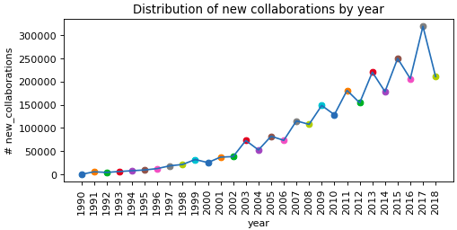
(2) How to interpret a time step?
SOA time step definition: G_{t} = (V_{t}, E_{t}) graph after event t | t∈N - #events occurred ((Node + Edge) and Edge event)
We have the state of the graph for each year, so a too small set of events to build the logarithmic vertex trajectories we want to match with our model.
Other metrics as event : the occurrence of a new author or a new collaboration.

Slide 89
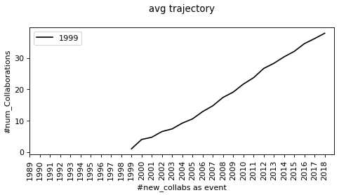
(2) How to interpret a time step?

Slide 90
(2) How to interpret a time step?
Vertex trajectories are stretched
Shown their logarithmic shape.

Slide 91
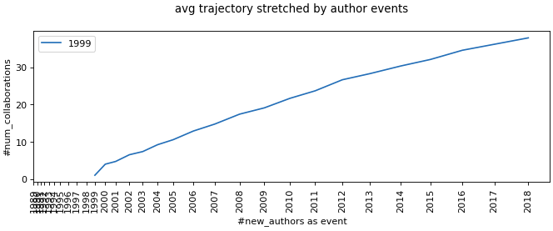
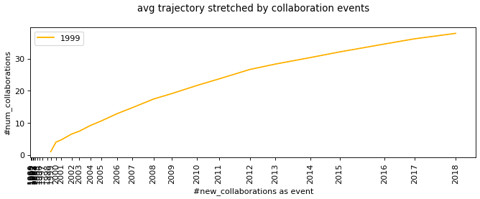
(2) How to interpret a time step?
Vertex trajectories are stretched on the x axis
Shown their logarithmic shape.

Slide 92
04
DEGREE DISTRIBUTION
Degree Distribution Retrieval
Degree Distribution Fitting

Slide 93
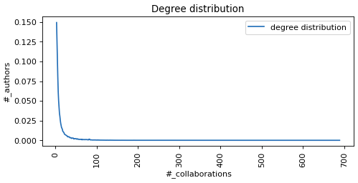
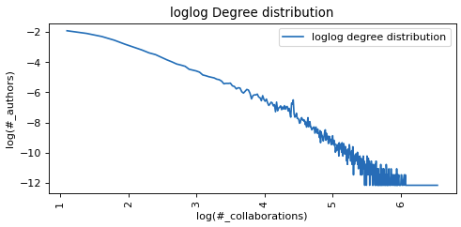
DEGREE DISTRIBUTION RETRIEVAL
To acquire more knowledge from the character of the data the degree distribution is found, taking the #authors with a given #collaborations. ​

Slide 94
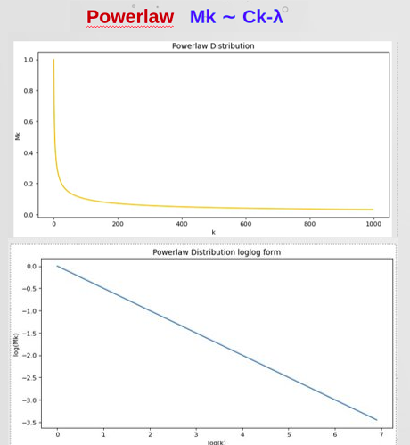
DEGREE DISTRIBUTION FITTING
To acquire more knowledge from the character of the data the degree distribution is found, taking the #authors with a given #collaborations. ​

Slide 95
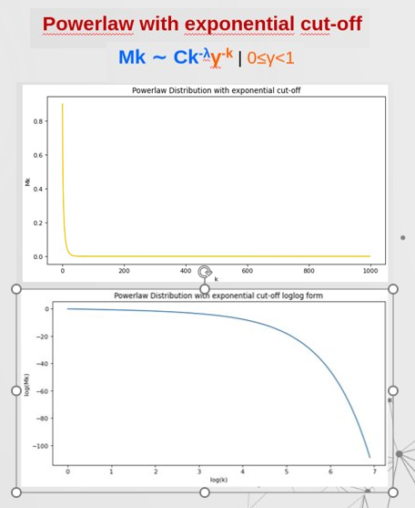
DEGREE DISTRIBUTION FITTING
To acquire more knowledge from the character of the data the degree distribution is found, taking the #authors with a given #collaborations. ​

Slide 96
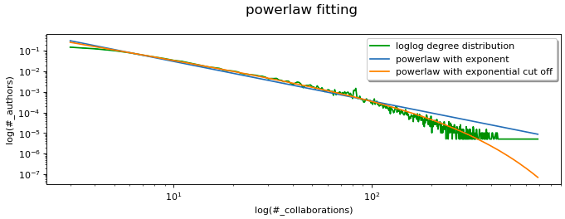
DEGREE DISTRIBUTION RETRIEVAL
To acquire more knowledge from the character of the data the degree distribution is found, taking the #authors with a given #collaborations. ​

Slide 97
05
VERTEX TRAJECTORIES
Average Trajectories
Fitting Trajectories
General Fitting
Results

Slide 98
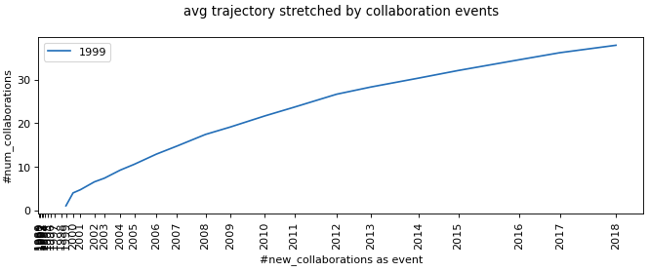
AVERAGE TRAJECTORIES
Computed and plotted the average trajectory of active authors by starting year.

Slide 99
AVERAGE TRAJECTORIES
Computed and plotted the average trajectory of active authors by starting year.
The x-axis is stretched by the number of new collaborations as events.

Slide 100
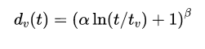
FITTING TRAJECTORIES
Average trajectories are fitted one by one using the logarithmic function representing the theoretical vertex trajectory.

Slide 101
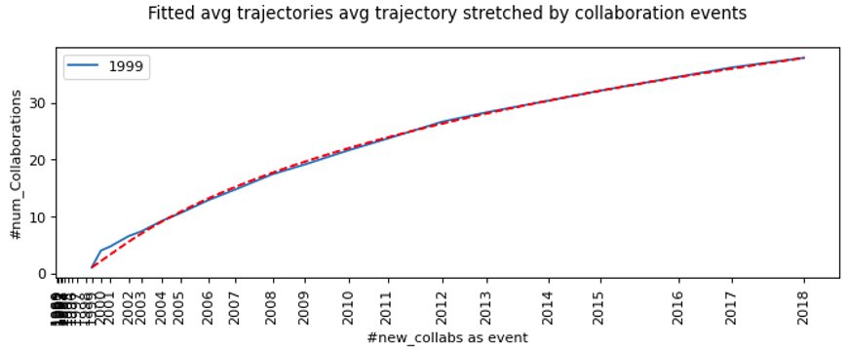
FITTING TRAJECTORIES
Average trajectories are fitted one by one using the logarithmic function representing the theoretical vertex trajectory.
Obtainined a couple of individual parameter α, β for each.

Slide 102
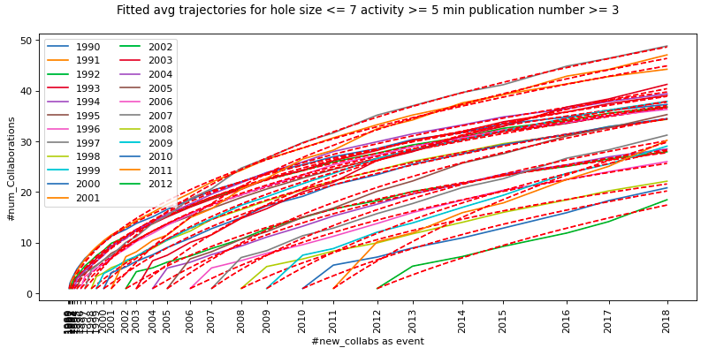
FITTING TRAJECTORIES

Slide 103
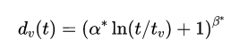
FITTING TRAJECTORIES

Slide 104
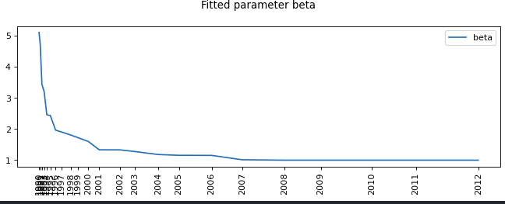
FITTING TRAJECTORIES

Slide 105
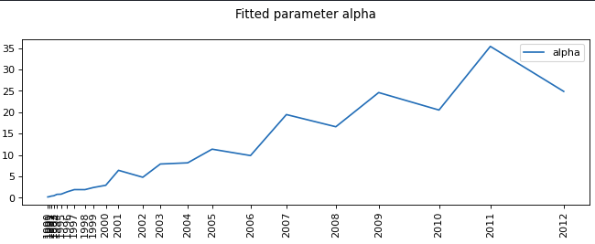
FITTING TRAJECTORIES

Slide 106
GENERAL FITTING
Find d_{v}(t)=(α* ln(t/t_{v}) + 1)^{β*} | α* and β* fit all curves minimizing the given error.
Four different kind of errors:

Slide 107
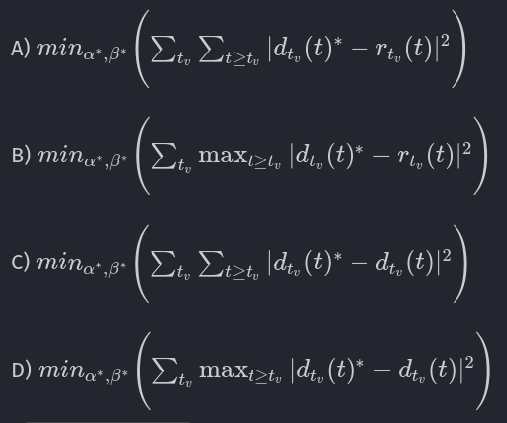
GENERAL FITTING
Find d_{v}(t)=(α* ln(t/t_{v}) + 1)^{β*} | α* and β* fit all curves minimizing the given error.
Four different kind of errors:

Slide 108

GENERAL FITTING
Find d_{v}(t)=(α* ln(t/t_{v}) + 1)^{β*} | α* and β* fit all curves minimizing the given error.
Four different kind of errors:

Slide 109

GENERAL FITTING

Slide 110

GENERAL FITTING

Slide 111

RESULTS
Real Data
​M_{k}

Slide 112
RESULTS
Real Data
Theoretichal model
0≤γ<1 ​
f(d_{v}(t)) = dv(t)^{γ}
​M_{k}
​M_{k}

Slide 113
RESULTS
Real Data
Theoretichal model
0≤γ<1 ​
f(d_{v}(t)) = dv(t)^{γ}
​M_{k}
​M_{k}
d_{v}(t)

Slide 114
RESULTS
Real Data
Theoretichal model
0≤γ<1 ​
f(d_{v}(t)) = dv(t)^{γ}
​M_{k}
​M_{k}
d_{v}(t)
=>
β seems to be 1

Slide 115
RESULTS
Real Data
Theoretichal model
0≤γ<1 ​
f(d_{v}(t)) = dv(t)^{γ}
​M_{k}
​M_{k}
d_{v}(t)
d_{v}(t)
=>
β seems to be 1

Slide 116

RESULTS
=>
Real Data
Theoretichal model
0≤γ<1 ​
f(d_{v}(t)) = dv(t)^{γ}
​M_{k}
​M_{k}
d_{v}(t)
d_{v}(t)
β seems to be 1
=>

Slide 117
RESULTS
=>
Real Data
Theoretichal model
0≤γ<1 ​
f(d_{v}(t)) = dv(t)^{γ}
​M_{k}
​M_{k}
d_{v}(t)
d_{v}(t)
β seems to be 1
γ = 0 and f(d_{v}(t)) = 1
=>

Slide 118

RESULTS
=>
Real Data
Theoretichal model
0≤γ<1 ​
f(d_{v}(t)) = dv(t)^{γ}
​M_{k}
​M_{k}
d_{v}(t)
d_{v}(t)
β seems to be 1
γ = 0 and f(d_{v}(t)) = 1
=>

Slide 119

RESULTS
=>
Real Data
Theoretichal model
0≤γ<1 ​
f(d_{v}(t)) = dv(t)^{γ}
​M_{k}
​M_{k}
d_{v}(t)
d_{v}(t)
β seems to be 1
γ = 0 and f(d_{v}(t)) = 1
=>

Slide 120
06
NEXT STEPS

Slide 121
NEXT STEPS
The underlying theoretical model may be different from the one we assumed at the beginning:
Next steps:
Generating a network on a given theoretichal model (f(d_{v}(t)=1) to fit our data;
Generating slightly different networks to check which represent better our case;
Defining a new theorethical model describing better the discovered behavior;
The analysis of data from other research field;

Slide 122
References:​
Derek J. de Solla Price. Networks of scientific papers, doi:10.1126/science.149.3683.510.​
Michalis Faloutsos, Petros Faloutsos, and Christos Faloutsos. On power-law relationships of the Internet topology, doi:10.1145/316188.316229.​
Frédéric Giroire, Nicolas Nisse, Thibaud Trolliet, Malgorzata Sulkowska. Preferential attachment hypergraph with high modularity, arXiv:2103.01751.​
A. D. Broido and A. Clauset, “Scale-free networks are rare,” doi: 10.1038/s41467-019-08746-5.
Mark E. J. Newman. Coauthorship networks and patterns of scientific collaboration, doi:10.1073/pnas.0307545100.
Mark E. J. Newman. Clustering and preferential attachment in growing networks, doi:10.1103/PhysRevE.64.025102.
A.-L. Barabasi and R. Albert, “Albert, R.: Emergence of Scaling in Random Networks. Science 286, 509-512,” Science (New York, N.Y.), vol. 286, pp. 509–12, Nov. 1999, doi: 10.1126/science.286.5439.509.
F.Giroire, N.Nisse, M.Sulkowska, Study of a degree distribution and a vertex tra- jectory in the Chung-Lu model with a generalized attachment function, 2022

Slide 123


Slide 124

WINDOW-SECTION FITTING
The same procedure is applied to five year windows and considering only the first eight year section of each trajectory.

Slide 125


WINDOW-SECTION FITTING
The general fitting this time is performed of the A and C errors type defined previously obtain the following parameters.

